Slide 1


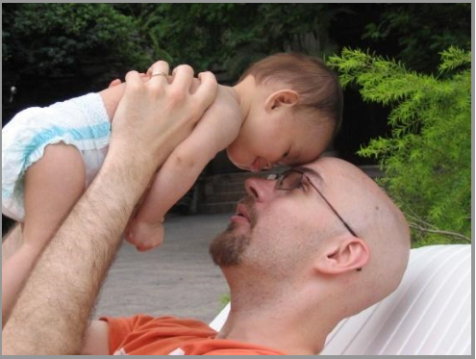

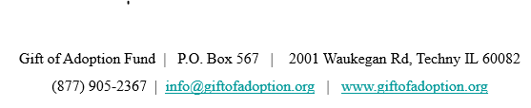

Slide 2
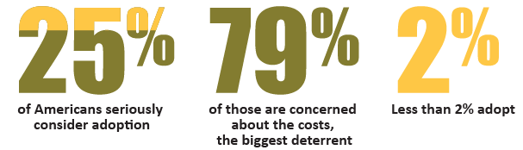
The Case for Helping Families Adopt
153,000,000 children worldwide and 400,000 in the U.S. are growing up without families.
18 million children overseas and 25% of the children in foster care need a family right now
Given 250,000 adoptions a year the probability of being adopted is only 1½ %
The odds are stacked against the child who grows up without a family:
In the U.S:
  25% will experience mental illness
  Less than 3% will earn a college degree
  20% will be homeless after age 18
  50% will be unemployed at age 24
  Overseas:
  Developmental delays due to lack of attention and nutrition
  Likely victims of sex trafficking and trade and guerilla militia activities
Yet, there are thousands of families who would adopt if the financial barriers to adoption were lower.
2
Notes:
2

Slide 3
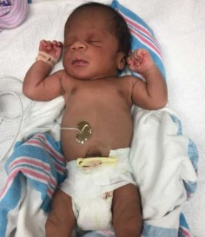
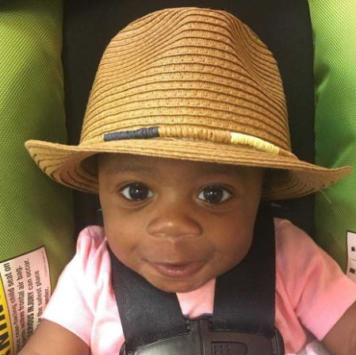

Gift of Adoption Grants Transform the Lives of Parentless Children
Gift of Adoption Fund provides the final funds to complete the adoption process, uniting more children with safe, permanent and loving families.
Jonas, adopted by teachers Alisha and Erik of Kaysville, Vermont
OUR PRIORITIES:
Children destined for foster care placement
Keeping siblings together
Children with medical needs
Children aging out of an orphanage or care system
3
Notes:
3

Slide 4
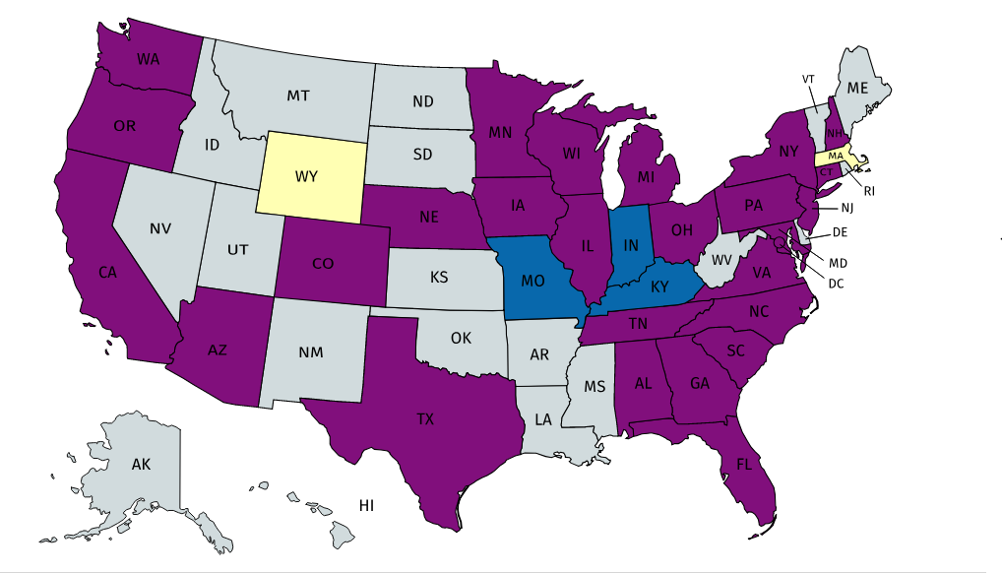
22 Years of Experience with Unique Position
  Since 1996, Gift of Adoption has provided $7.8 million in grants to help over 2,650 children
  Most visible adoption funding charity with volunteer led chapters in 22 states
    250 board members and volunteers
    3,000 donors
  Solid partnerships with accredited adoption agencies and adoption lawyers nationwide
  Grants are awarded without regard to religion, race, sexual orientation, marital status, etc.
  Grants of up to $15,000 awarded monthly.
GOA Chapter Map
December 2018
Purple: Current chapter
Blue: Emerging chapter
Yellow: Pipeline
4
Notes:
4

Slide 5
Win-Win Outcomes
Gift of Adoption grants are a win-win on multiple levels:
For the child: Adoption provides not only a family, but also bedtime stories, an education, a chance to learn a musical instrument or how to swim, braces, family camping trips, and so much more—allowing the child to reach his or her full potential regardless of the circumstances of birth.
For society: Helping a child get adopted reduces current and future costs to society, estimated to be $300,000 per child in foster care. (Jim Casey Youth Opportunities Initiative)
No other charitable initiative delivers this transformational impact for such a small investment—not just for the child served, but for generations following.
As the largest nondiscriminatory funder of adoption assistance grants, Gift of Adoption is poised to lead this new philanthropic priority.
You don’t need to adopt to give a child a family.
5
Notes:
5

Slide 6
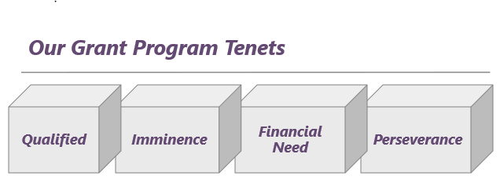
Who We Serve
Gift of Adoption grants allow hard working, loving families to say “yes” to a child in need.
U.S. citizens with approved home studies from COA/Hague accredited agencies, adopting children from anywhere in the world.
Occupations: 20% in Education; 12% Small Business Owners; 9% Clergy/Nonprofit; 9% Military/Civil Service; 9% Medical fields
6
Notes:
6

Slide 7
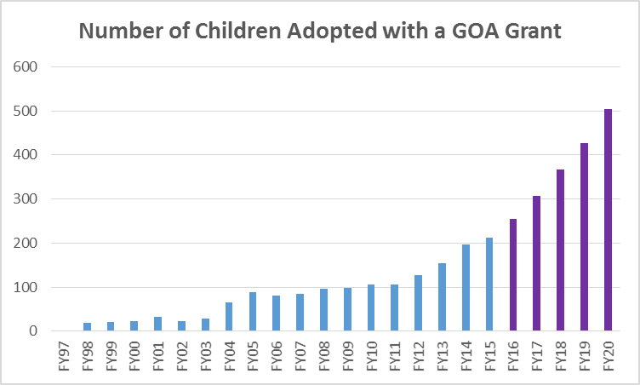
Our 500 in 5 Plan Will Double our Impact in One Quarter of the Time
500 in 5 Growth Plan launched in July of 2015 to meet unmet need and accelerating demand for adoption assistance.
2015 to 2020:
5 Years/1857 Children
1996 to 2015: 20 Years/1565 Children
7
Notes:
7

Slide 8
Vision: Help 500 Children Annually
Signature Event
Program ($400k):
Grant Selection | Referral Outreach
Administrative Operations ($400k):
IT ǀ Financial Management | Fundraising ǀ Donor Stewardship ǀ
Marketing | Web ǀ Public Relations
25 National Board
100 Investor Board
30 Regional Chapters
$1,200,000 to Grants
$1,640,000 to Grants
Family Foundations
Corporate & Community Giving Circles
Vision: 500 Children by FY 2020 by growing Gift of Adoption’s annual revenue from $1.3m to $2.44m
$440,000 to Grants
Notes:
8

Slide 9
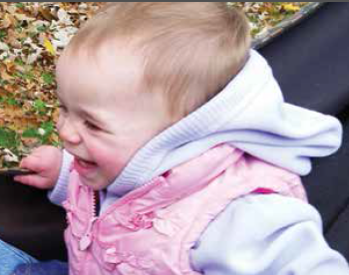
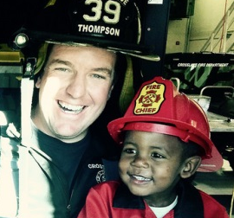
Together, We Can Move the Needle on Adoption
Together, We Can Help More Children with the Gift of Adoption
“Eliana will grow up in a stable home free of substance abuse. She would have ended up in the foster care system if we had not been there to adopt her. She will have access to good medical care, a strong education, and will have a big extended family who loves her a lot!”
“Issac was found abandoned in Ethiopia when he was one month old. When attempts to find relatives were exhausted, adoption became a way for him to have a family. Gift of Adoption’s support in getting him home means more than you could ever know.”

