Slide 1


Social Media and Storytelling Quick 5
Social Media & Storytelling
Quick 5

Slide 2
Social Media: Housekeeping
This Quick 5 is meant to focus on Gift of Adoption framework for social media and storytelling rather than a training on how to post on social media and how to manage social media.
If you need training on how to manage and post on social media, there are many help guides and forums available on Facebook and Instagram.
You can also message us at chaptersupport@giftofadoption.org and we would be happy to set up a one-on-one 15-minute training to get you up and running on your chapter's social platform.

Slide 3
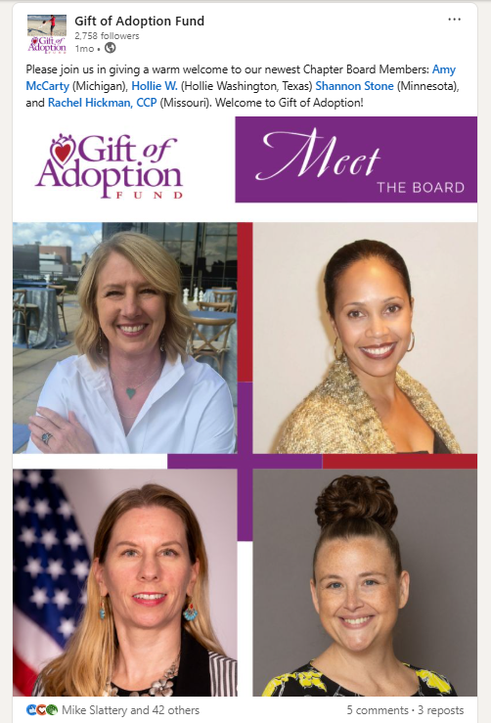
Social Media: National
Gift of Adoption National is active on the following platforms, please follow us:
Facebook
Instagram
LinkedIn
TikTok
Vimeo
YouTube
We love to introduce our newest chapter board members on LinkedIn!

Slide 4
Social Media: Chapter Pages
All chapters have an active Facebook page:
All chapters should have at least one chapter board member who has admin access for their Facebook page and responsible for posting chapter specific content.
If a chapter does not have someone assigned, they should encourage a chapter board member to take on this role and/or recruit a volunteer to do so.
Chapters can also have an Instagram, if you do not have one and would like one message chaptersupport@giftofadoption.org.
National holds and manages one presence on LinkedIn, TikTok, YouTube, Vimeo and chapter board members are encouraged to share content via their personal pages vs creating a chapter page.
If you are not sure where your chapter stands on social media, email chaptersupport@giftofadoption.org and we can connect

Slide 5

Social Media: Management
Gift of Adoption is now using a social media management tool, Hootsuite!
What does this mean for chapters?
What National Will Handle
The national office will now manage core mission content and scheduling through Hootsuite, including:
Posting grant stories across chapter pages
Sharing national campaigns and announcements
Maintaining consistent branding and messaging
Scheduling posts to maintain regular posting cadence
Providing graphics and templates for chapters to use

Slide 6
Social Media: Management
What Stays the Same
Each chapter will still have admin access to their pages
National will still create Facebook events and schedule sponsor posts
Chapters should still post when they have local stories or activities
Chapters are still encouraged to send photos or stories that national can turn into posts
Board members should still share content to their personal pages and invite supporters to engage

Slide 7
Social Media: Management
What Chapters Should Focus On
Each chapter social media team should aim to:
✔ Engage with 3–5 posts per month across platforms ✔ Share 1–2 local posts per month ✔ Submit photos/stories from local activities to national ✔ Amplify national posts when relevant
✔ Recruit and grow local audience

Slide 8
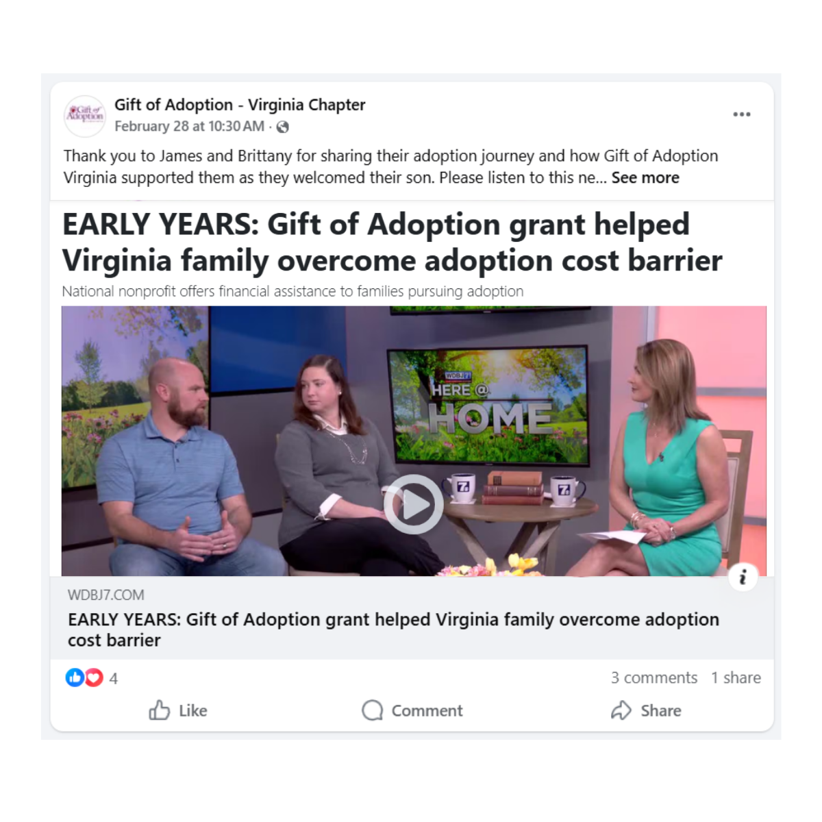
Social Media: Chapters Post Ideas
Posts photos and celebrations from your fundraising event and tag people if you know them.
If you speak at a community group, ask for a photo and share it on social media
Chapters who receive media coverage should post the link to their media coverage on their social site
Celebrate chapter milestones, like total number of adoptions completed, funds distributed for adoption, years of service. This information can be found on your Chapter Fact sheet on your chapter website.
Example: Virginia Chapter sharing a local news story about a GOA grant family

Slide 9
Social Media: How Can I Increase My Audience?
Ask all your chapter board members who are active on social media to invite their network to follow your chapter social media page(s)
Share any GOA national posts on your page because "Sharing" help boost reach and audience for all
Follow organizations/groups who are working parallel to GOA such as your past event sponsors/supporters, community foundations who have provided your chapter with grant funding, local adoption/foster care agencies, local adoptive parent associations/groups.
When posting tag the company (if appropriate) and it will increase the chance of the post appearing in the feeds of followers of the company which may convert them to followers of the chapter page.
Share adoption related news that is in alignment with GOA's values.
If you are not sure if it is ok to share, reach out to chaptersupport@giftofadoption.org and ask.

Slide 10
Social Media Policy
Important takeaways:
GOA is committed to keeping the focus of our communications on our mission and keeping a positive representation of the GOA brand across all social media platforms.
GOA grants are awarded without regard to an applicant's race, ethnicity, age, religion, marital status, or sexual orientation.
Anyone posting should honor GOA's non-discriminatory policy and avoid partisan political statements or evangelizing for anything other than the cause of adoption.
Before sharing photos of families, always check in with us at chaptersupport@giftofadoption.org to make sure we have the family’s permission on-file.
Always avoid sharing the family’s last name and other potentially identifying information, like their town of residence or the adoption agency they’re working with.
Please refrain from creating social media accounts for your chapter on any additional platforms. If you’d like to open an account on Instagram please reach out to Chapter Support.
View Full Policy Here

Slide 11
Social Media: Responsibly Sourced Stories
Full Guide Located here: Responsibly Sourced Stories Guide
Terms To Avoid | Positive Adoption Language | Subject
Give up for adoption, put up for adoption, give away, adopted out, abandoned | Make an adoption plan, choose adoption, place child for adoption, terminate parental rights | Birthparent
To keep her child | To parent her child | Birthparent
Adopted child or Own child | child/son/daughter | Child
Special needs child | Child with special needs | Child
Adoptee | Person who was adopted | Child
Adoptive parent/father/mother | Parent, mother, father, mommy, daddy | Family
Forever Family | “permanent family,” “permanent, loving family, or “permanent loving family through adoption.” We choose these words rather than “forever family” to honor a child’s parents by birth as well as remaining aware that disruptions within adoptions do occur. | Family
Foreign adoption | International Adoption/Intercountry | General

Slide 12
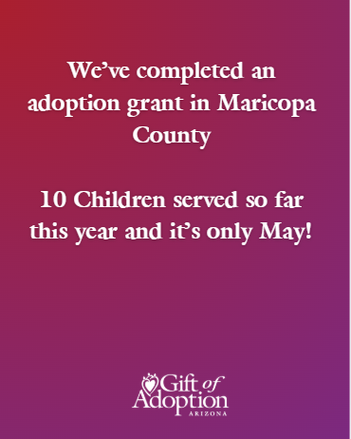
Social Media: Grant Related Posts
Every month, many of our chapters complete grants and the results are visible on your chapter plan. Here is an example of how you can post about these on social media and avoid sharing personal details about the child.
We've completed an adoption grant in XX County! XX children served in 2026!
More than $XX,XXX invested in grants so far this year! Every dollar makes a difference!
You can post them as just text on a color background.

Slide 13
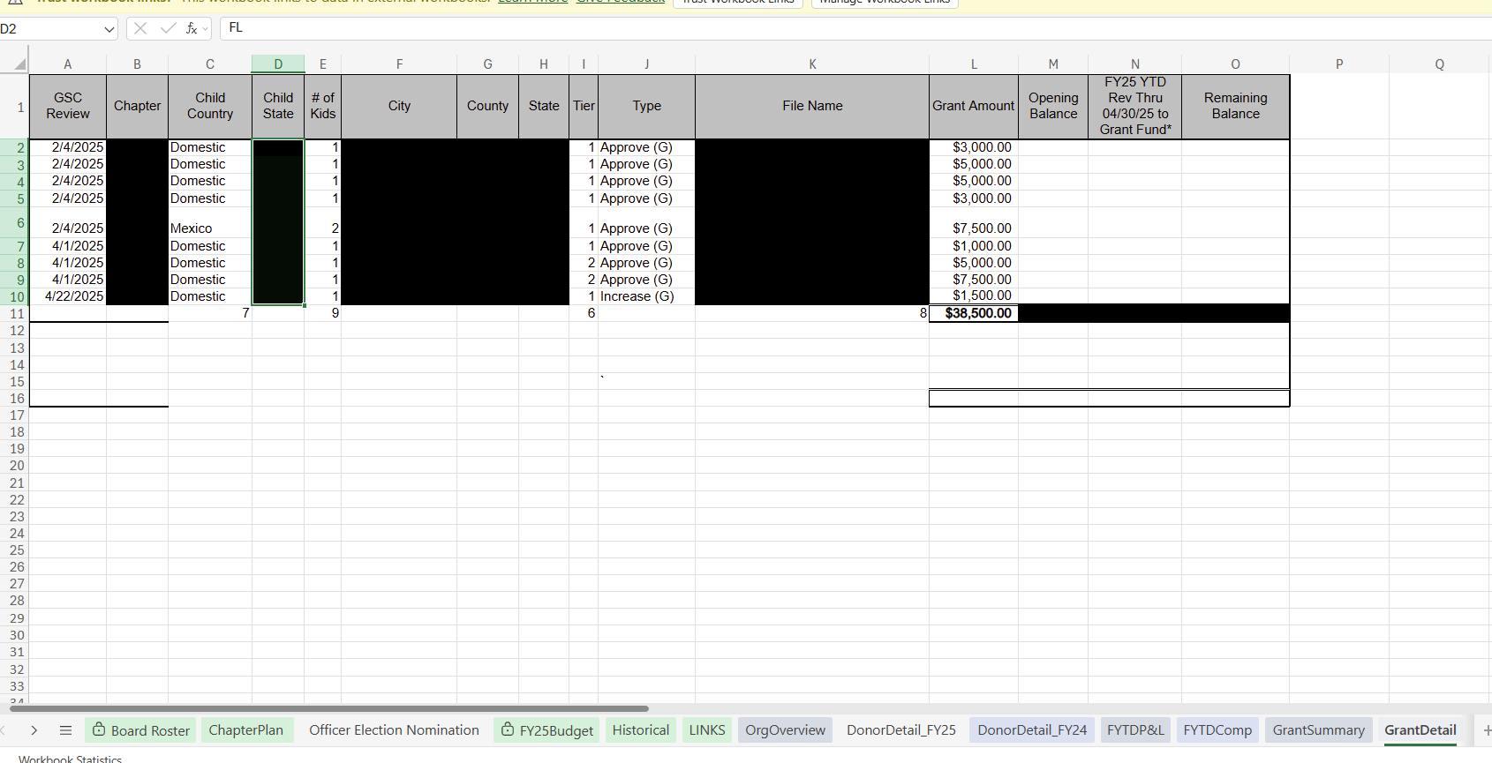
Social Media: Grant Related Posts
Grant details are updated every month on your chapter plan which you receive via email around the 15th of each month.
Click on the GrantDetail Tab
Fields: Type, Approved (G) means there's a grant approved
Child Country is how you can use language like domestic or international adoption
If two children are listed as part of the adoption, it could indicate this is an example of preserving a sibling group (confirm by emailing chaptersupport@giftofadoption.org)
Note: I blacked out the details since this is a training, on your plan this information is visible.

Slide 14

Social Media: Milestone-Related Posts
Celebrating our 10th grant of the year! Excited to bring so many families together through your support.
Join us in celebrating our 5th Anniversary as a Chapter by making a making a gift today.
We've just invested more than $1,000,000 in grants!
You can post them as just text on a color background or use a stock image that DOES NOT include faces.

Slide 15
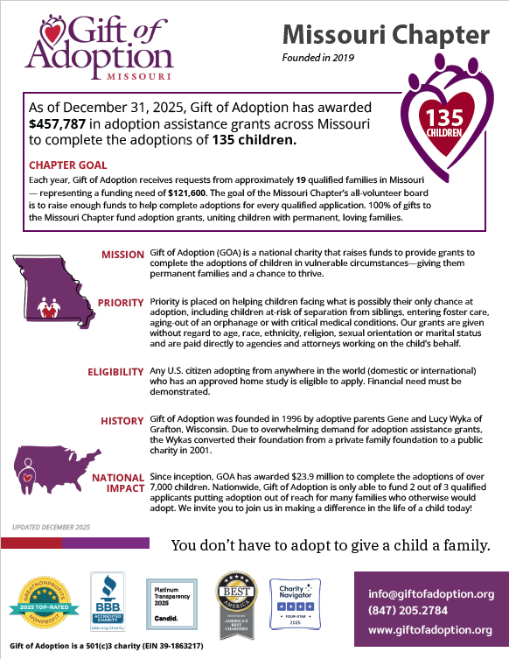
Social Media: Where To Find Milestone Info
Your Chapter Fact Sheet is a great info source and is located on your chapter website here:
https://giftofadoption.org/get-engaged/
Use Chapter Fact Sheets as a baseline for where you started the year.
Using Missouri Chapter as an example, by looking at the Grant Detail tab you can track progress and celebrate serving 135 children since your inception in 2019, or when you reach $500,000 in grants awarded, etc.
Year Founded
Total Children served
Total Awarded in grants

Slide 16
Social Media
Thank you for your help raising awareness through
Social Media and Storytelling!
Questions?
chaptersupport@giftofadoption.org
Thank you!

